Slide 1
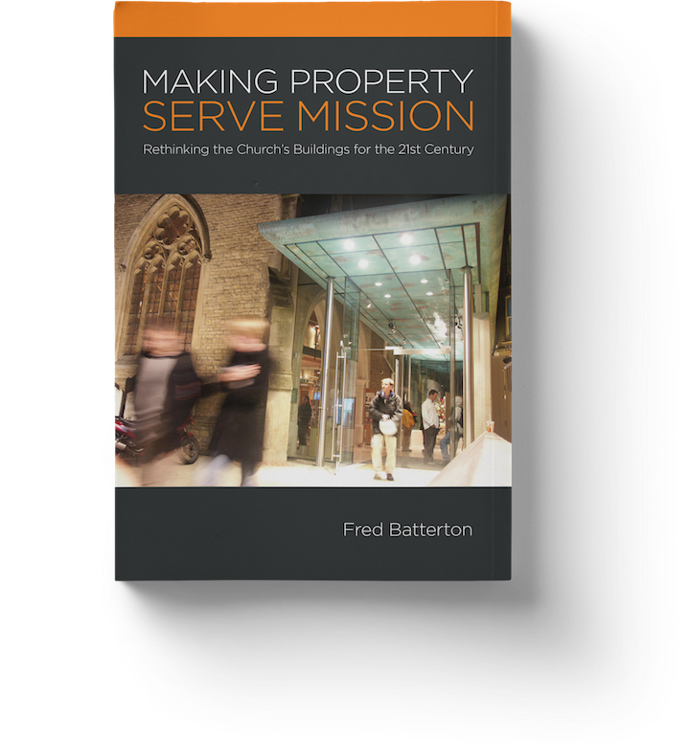
Part 1: What is Our Core Business?
Fred Batterton
Notes:
This series is based on the book “Making Properties Serve Mission – Rethinking the Church’s Buildings for the 21st Century” by Fred Batterton

Slide 2
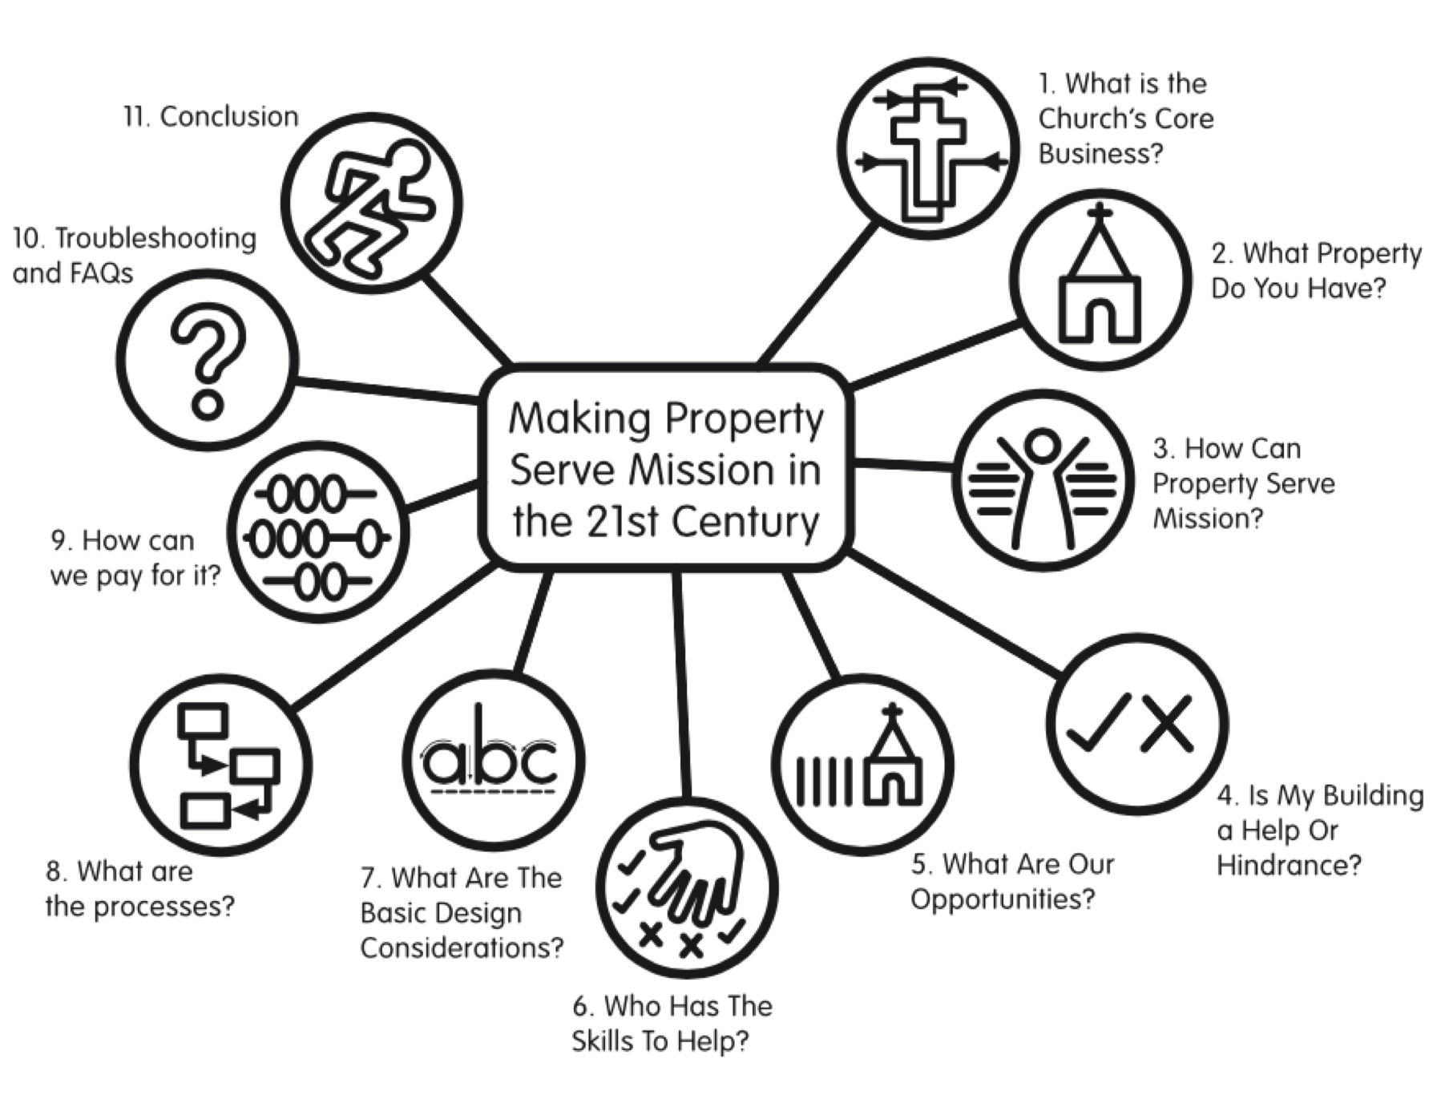
Notes:
This series will help us to reconsider the church’s buildings and what God is calling us to do.

Slide 3
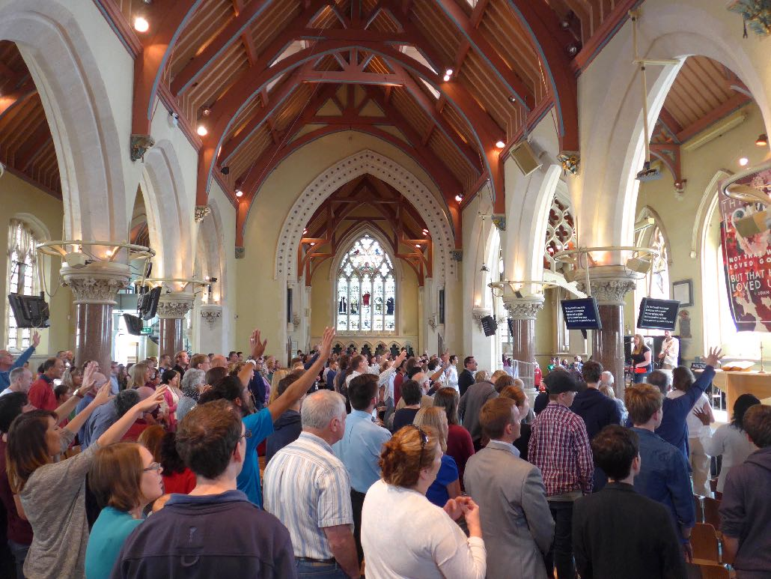
Core business
Notes:
Before thinking about the church’s buildings we need to agree why we are church.

Slide 4
Core Business for the Church?
“‘Love the Lord your God with all your heart and with all your soul and with all your mind.’ ..… And the second is like it: ‘Love your neighbour as yourself.”
Matt 22: 27-28
“…go and make disciples of all nations, baptising them in the name of the Father and of the Son and of the Holy Spirit, and teaching them to obey everything I have commanded you.”
Matt 28: 18-20
Notes:
The words of Jesus are clear. The Great Commandment and the Great Commission.

Slide 5
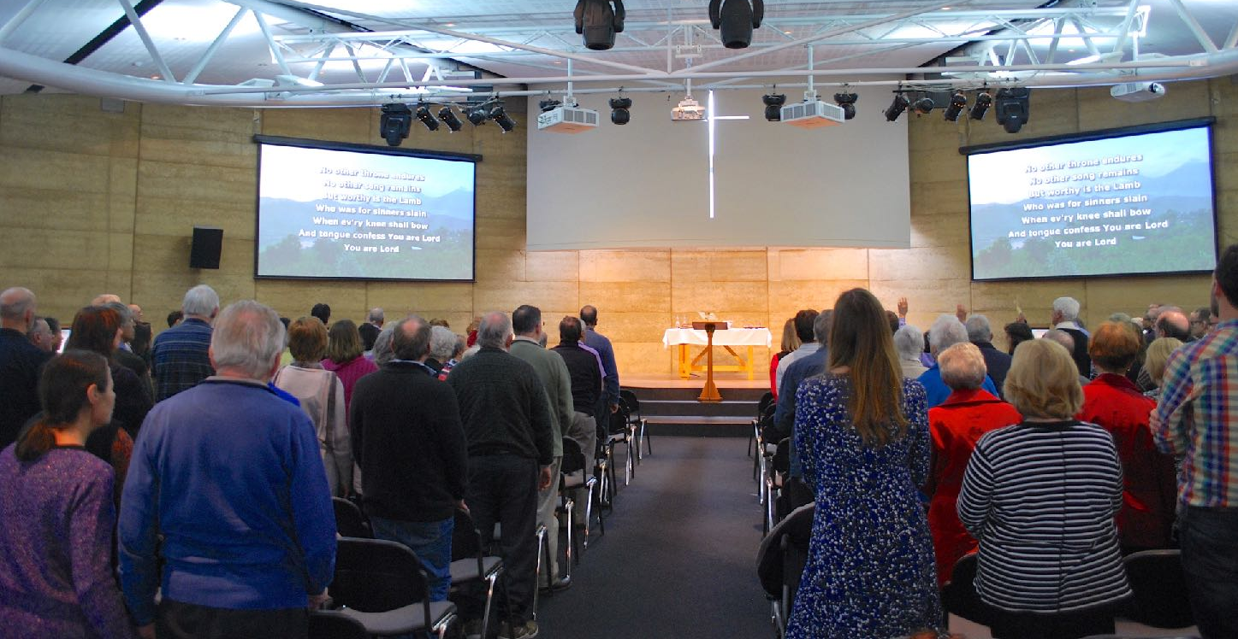
Worship, disciples, love
Notes:
We need to have a place to gather to appreciate our God.

Slide 6
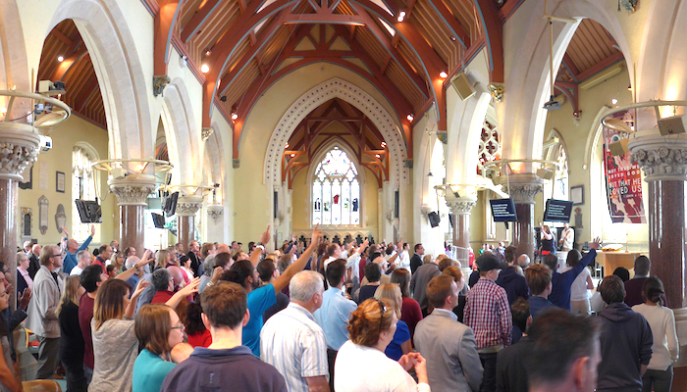
Worship, disciples, love
Notes:
The age of the building does not matter. Heritage buildings can be adapted to suit contemporary worship.

Slide 7
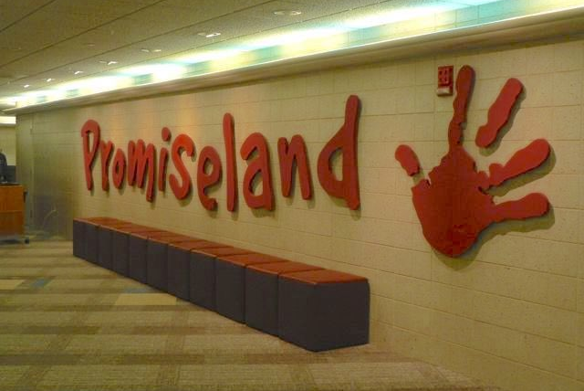
Worship, disciples, love
Notes:
Our kids need spaces for the same

Slide 8
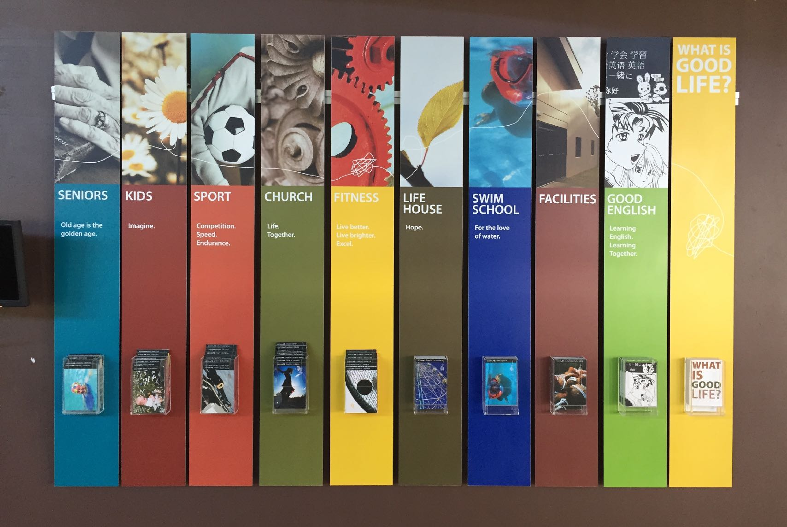
Worship, disciples, love
Notes:
Our buildings are to help and enable us in our mission. This postcard rack is in a sports centre in Qld that a church built to engage with and serve the local community. “Church” on Sunday is just one normal activity in the centre.

Slide 9
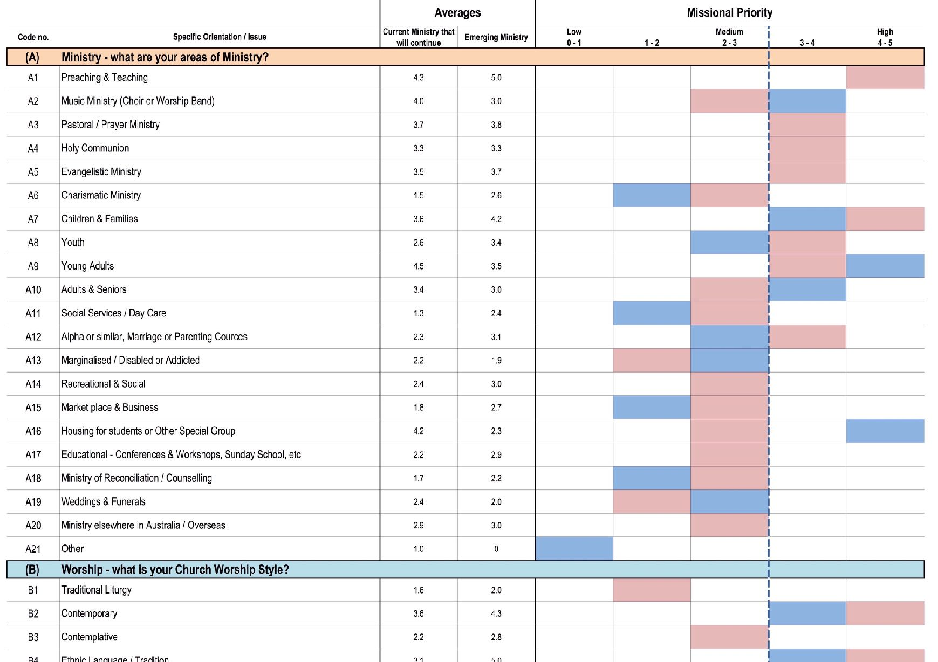
Missional identity
Notes:
What is our local mission calling? A questionnaire like this one can help us focus on priorities. This has 85 categories that leaders and members can score (contact Fred Batterton for more information)

Slide 10
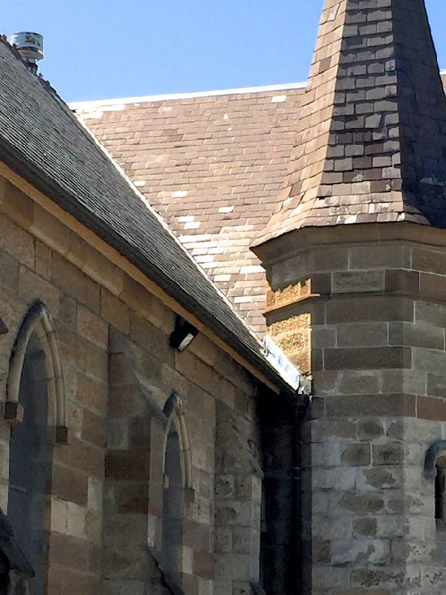
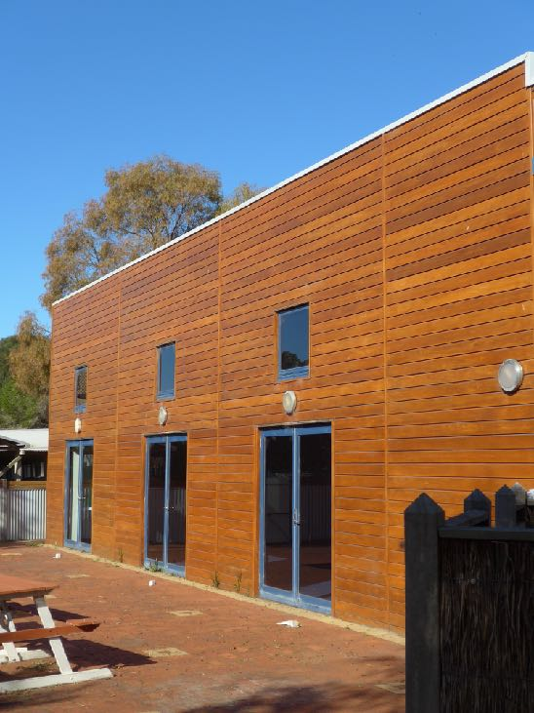
Next time: What buildings do we have?
Notes:
We will look at issues with each type of church buildings.

